Slide 1
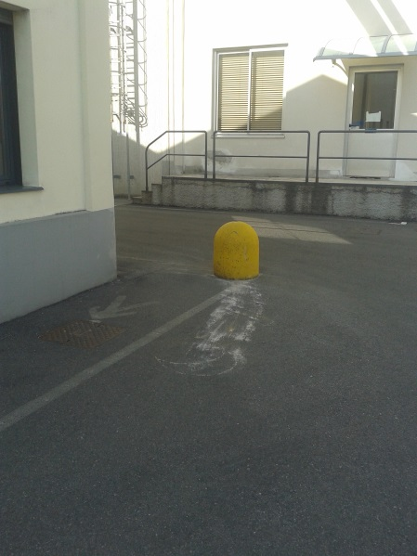
HS&E INCIDENT BULLETIN |  | January - September 2015
Location Country | Type of incident (example: Slip-Trip, Fall from Height, Vehicle , Laceration, Chemical Exposure)
Summary:
During a maneuver, a truck hit the bollard on the corner of footpath (to protect people in transit), forcing it to tilt dangerously
Root Causes: | Actions Taken Thus Far: Next Steps
Bollard not visible from inside the cabin; No flag fitted into the bollard | Ensure visibility during maneuver

